Slide 1
Confusion Matrix-Precision-Recall
Code Brigade

Slide 2
Why Use Evaluation metrics?
Evaluating a Model using Evaluation Metrics give us how good or bad a model is.
Ex:
Let’s say you built a model for Medical i.e. Cancer Diagnosis. This model will be very critical in coming up with conclusion for a patient. So, we need to have a model which gives good result. Or if not, the outcome could be fatal.

Slide 3
Evaluation metrics
Accuracy
Confusion Matrix
Precision
Recall
F1 Score
AUC ROC

Slide 4
Confusion matrix
A confusion Matrix is a table that helps understand performance of a classification model on test data for which true values are known.
This matrix relatively is very simple to understand but the terminologies related to this can confuse many.
 | Predicted Positive (1) | Predicted Negative (0)
Actual Positive (1) | TP | FN
Actual Negative (0) | FP | TN

Slide 5
Let us define the most basic terms associated with Confusion Matrix.
True Positive (TP): This is the number of times our model predicted YES and Actual output was YES.
True Negative (TN): The number of times out model predicted NO and Actual output was NO.
False Positive (FP): This is the number of times our model predicted YES and output was NO. (Type I Error)
False Negative (FN): The number of times our model predicted NO and the output was YES. (Type II Error)

Slide 6


Let’s consider the below Medical example.
Predicted value
 | Diagnosed Healthy | Diagnosed Sick
Actual Healthy | 118 | 12
Actual Sick | 47 | 15
Actual Value

Slide 7
Understanding the Matrix
Healthy People incorrectly predicted as sick
Healthy people correctly diagnosed healthy.
Predicted value
 | Diagnosed Healthy | Diagnosed Sick
Actual Healthy | True Positive | False Positive
Actual Sick | False Negative | True Negative
Actual Value
Sick people incorrectly predicted as healthy.
Sick people correctly predicted sick

Slide 8
Few other performance measure derived from confusion matrix
Precision
Recall/Sensitivity
Specificity

Slide 9
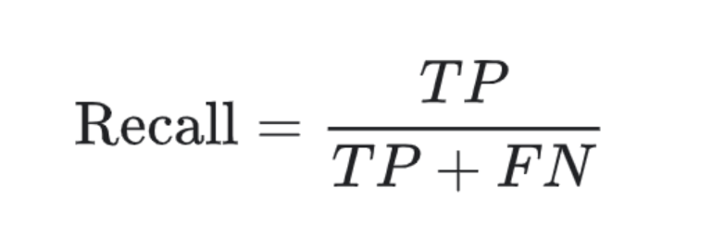
Recall/Sensitivity
Recall/Sensitivity is correctly predicted as positive to total number of positive. Be very careful here. In case of Precision we have denominator as total predicted as positive i.e. TP+FP while here we have total number of positive i.e. TP+TN. This means denominator takes total number of outputs we predicted correctly be it positive or negative class. The question that we answer here is, ‘What proportion of positive instance was actually classified correctly?’

Slide 10
Let’s consider the below Medical example.
Predicted value
Of all the actual diagnosed healthy, how many are classified as healthy.
 | Diagnosed Healthy | Diagnosed Sick
Actual Healthy | 118 | 12
Actual Sick | 47 | 15
Recall = TP/(TP+FN)
= 118/(118+12)
= 118/130
= 0.907
= 90.7%
Actual Value

Slide 11
Specificity
Measure of how often predictions are correct when actual value is negative.
Predicted value
Of all the actual diagnosed sick, how many are classified as sick.
 | Diagnosed Healthy | Diagnosed Sick
Actual Healthy | 118 | 12
Actual Sick | 47 | 15
Recall = TN/(FP+TN)
= 15/(47+15)
= 15/62
= 0.241
= 24.1%
Actual Value

Slide 12
precision
It’s the measure of how often predictions are correct when predicted value is positive.
Predicted value
Of all the predicted healthy, how many are actually healthy.
 | Diagnosed Healthy | Diagnosed Sick
Actual Healthy | 118 | 12
Actual Sick | 47 | 15
Recall = TP/(TP+FP)
= 118/(118+47)
= 118/165
= 0.715
= 71.5%
Actual Value

Slide 13
References
LinkedIn: https://www.linkedin.com/in/nikhiljain93/
YouTube: https://www.youtube.com/channel/UCsHTJbrvLJdrFMlM2ZnHyCw?view_as=subscriber
GitHub: https://github.com/njain5/
Medium: https://medium.com/@nikhiljain.gaya

Slide 14
Thank You !!!
Code Brigade

